Slide 1
Linking Datasets
Nia Comley | Data and analytics developer

Slide 2
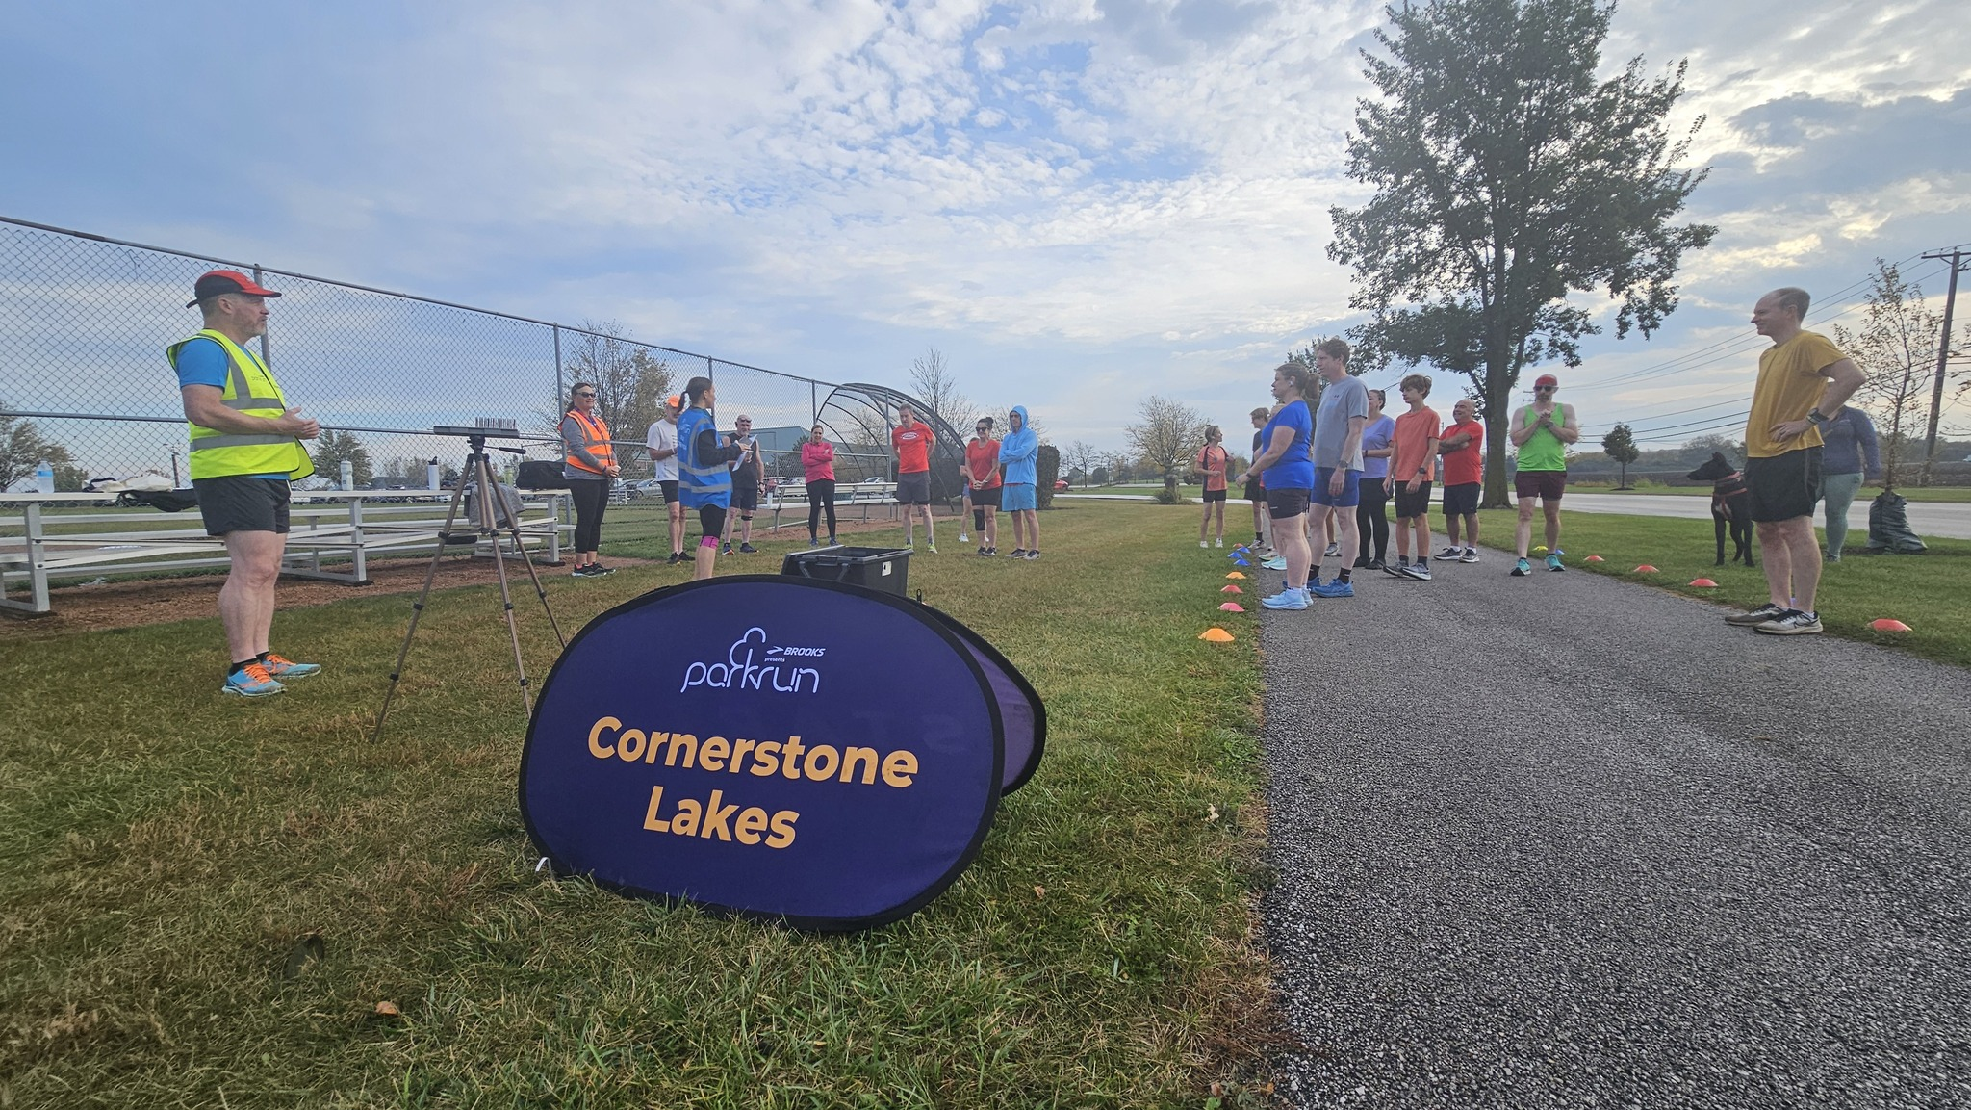
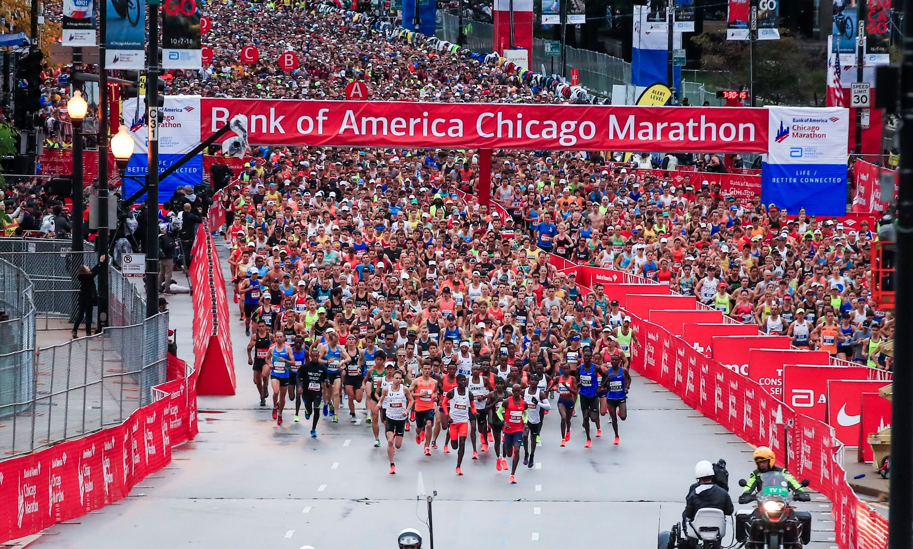
The Challenge: How do we link parkrun results data from the day before the 2024 Chicago Marathon to the official marathon results?

Slide 3
Background
Cornerstone Lakes parkrun #77
Cornerstone Lakes parkrun is the closest parkrun to Chicago city centre
Parkrun is a weekly timed 5k run.
Event 77 was held on the 12th October 2024.
Average number of finishers is 22.
Day before the 2024 Chicago marathon there were 153 finishers.
2024 Chicago Marathon
The Chicago marathon was held on the 13th October 2024
There were 52022 finishers.

Slide 4
Insights
Correlation between parkrun and marathon performance
Finish time relationship: faster parkrun = faster marathon? Fatigue vs activation.
Demographic insights
Age/gender trends: are younger runners more likely to do both events? Does gender distribution differ between parkrun only and marathon only participants?
Performance by age group: compare how different age groups handle back-to-back events
Predictive modelling
Marathon time prediction: can you predict marathon results based on demographic data and parkrun results?

Slide 5
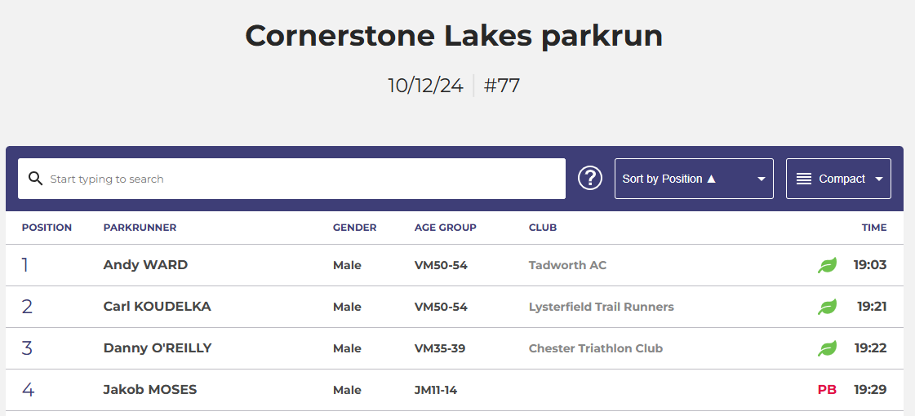
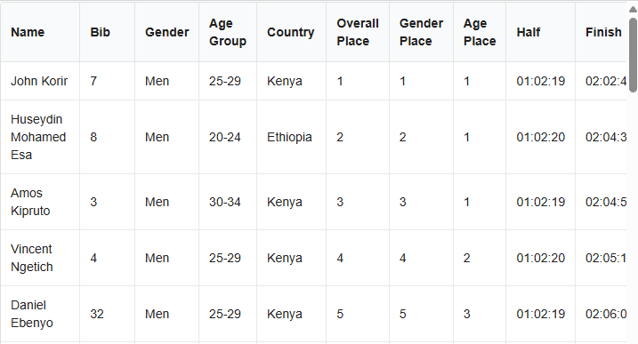
The Data
Cornerstone Lakes parkrun #77
2024 Chicago Marathon
Results published on parkrun website.
Copied the results to a CSV file.
Results posted on Chicago marathon website.
Data exported from Zenodo repository as a CSV.
Sources: https://chicago-history.r.mikatiming.com/2024/
https://zenodo.org/records/14174121
Source: https://www.parkrun.us/cornerstonelakes/results/77/

Slide 6
Goal: Fuzzy match on Name. Exact match on Age Group and Gender

Slide 7
Techniques for matching

Slide 8
Exact match
Direct comparison of fields - records must match character-for-character
Best for standardised, clean data with unique identifiers
Example:
Record 1 | Record 2 | Match?
John Smith | John Smith | Match ✅
Advantages | Disadvantages
Fast and efficient No false positives Simple to implement Clear logic | Fails on any inconsistencies such as formatting, typos and trailing spaces Requires clean data which is rare in real world examples No tolerance for human error

Slide 9
Exact matching: Failures
Case
Record 1 | Record 2 | Match?
John Smith | john smith | No match ❌
Typos
Record 1 | Record 2 | Match?
John Smith | Jon Smith | No match ❌
White space
Record 1 | Record 2 | Match?
John Smith | John Smith | No match ❌
Special characters
Record 1 | Record 2 | Match?
John O’Smith | John OSmith | No match ❌

Slide 10
Fuzzy matching
Algorithms that measure similarity between strings, allowing for variations
Best for when data is messy, inconsistent and has variations (e.g. typos, formatting differences etc)
Example:
Record 1 | Record 2 | Match?
John Smith | jon smith | Match ✅
Advantages | Disadvantages
Can find matches without a unique identifier Better for real world data Flexible | Risk of false positives Slower than exact matching Requires more parameter tuning and validation testing

Slide 11
Fuzzy matching: Methods
There are many algorithms to use for fuzzy matching. We will focus on the following:
Levenshtein Distance
Jaro-Winkler Distance
Counts minimum edits required to transform one string to another.
Good for typos
Example:
Jon Smith → John Smith (1 edit)
Gives more emphasis to character matches at the start of strings
Good for names
Example:
Jon → Jonathan

Slide 12
Linking the Parkrun results and Chicago Marathon results datasets using Python

Slide 13
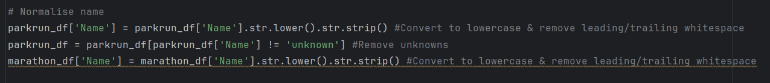
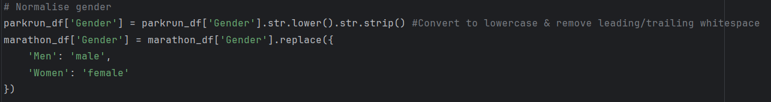
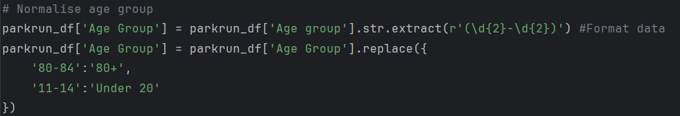
Data Cleansing
After importing the data into PyCharm as a pandas dataframe, it is important to cleanse the data for consistency between the two datasets.
Name field:
Gender:
Age group:

Slide 14
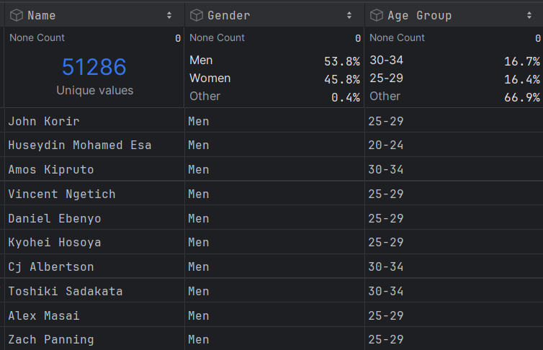
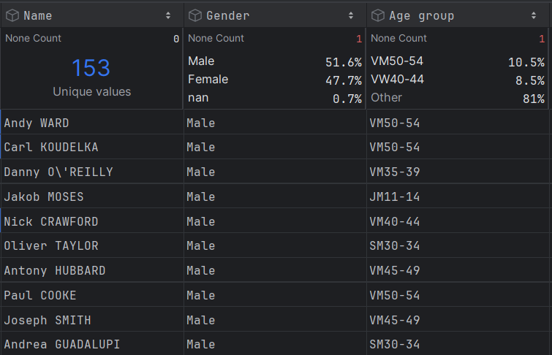
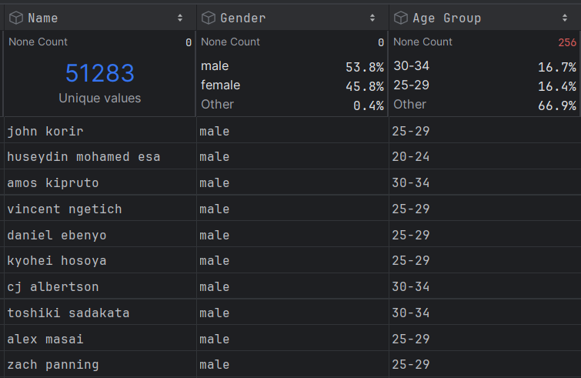
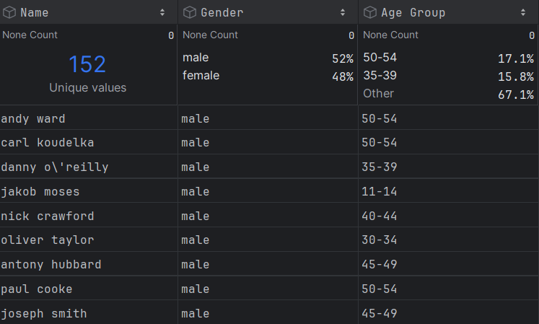
Data Cleansing: Before and after
Before
After
Before
After
Cornerstone Lakes parkrun #77
2024 Chicago Marathon

Slide 15
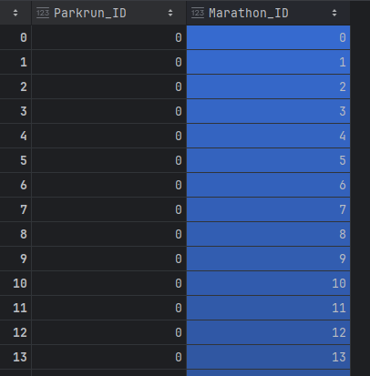
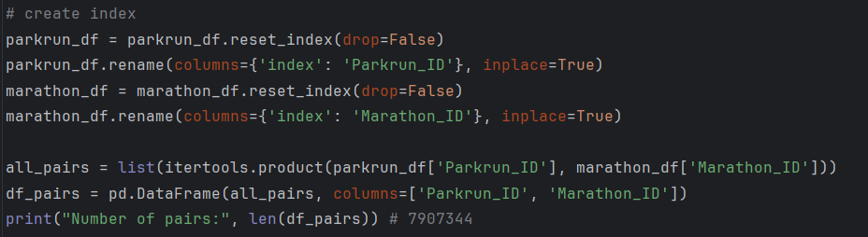
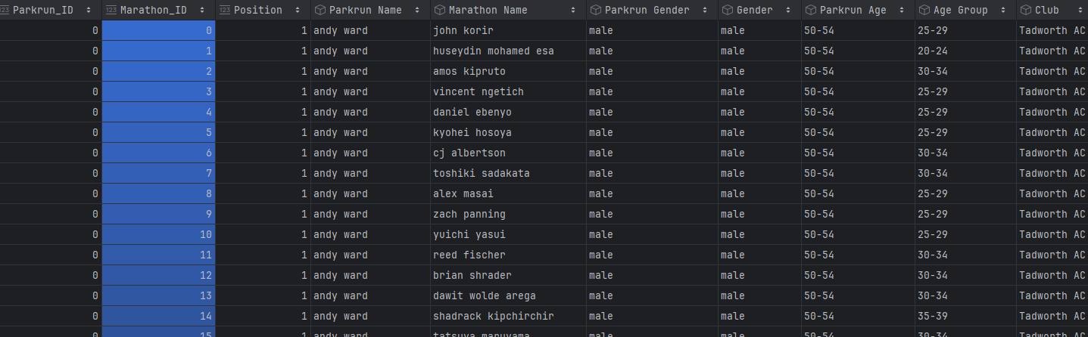
Fuzzy matching Names: combining datasets
We create an index column on both the parkrun dataframe and the marathon dataframe.
We create a new dataframe where we use both these indexes to generate all possible pairs between the two dataframes.
We merge this result back together with the cleaned parkrun and marathon data frames so we can create the similarity scores.

Slide 16
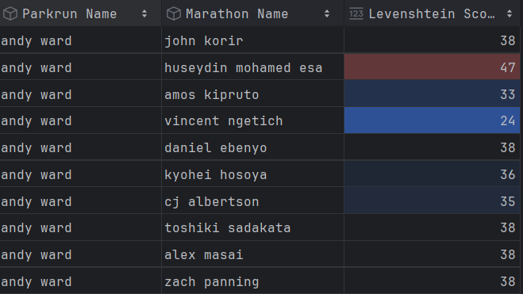
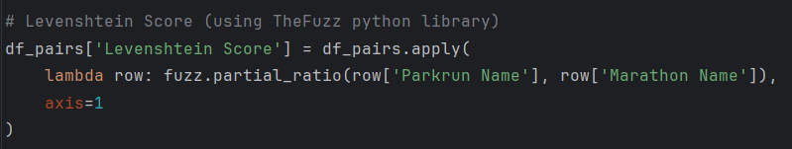
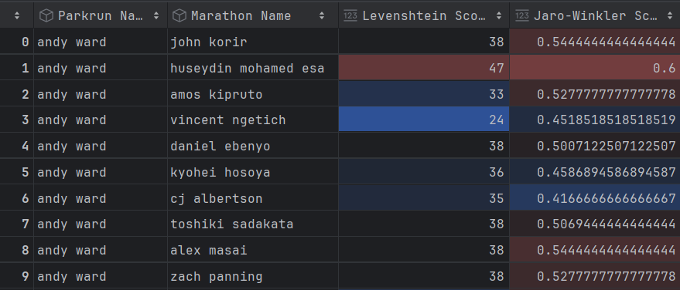
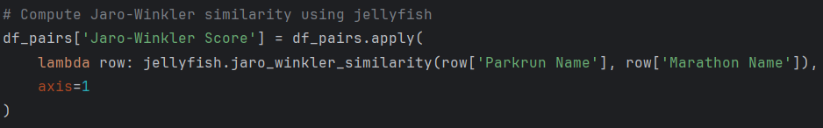
Fuzzy matching Names: Similarity scores
Levenshtein Score
We then generate a Levenshtein Score for each pair using TheFuzz Python library.
Levenshtein similarity score is between 0 and 100.
Jaro-Winkler Score
We then generate a Jaro-Winkler Score for each pair using jellyfish Python library.
Jaro-Winkler similarity score is between 0 and 1.

Slide 17
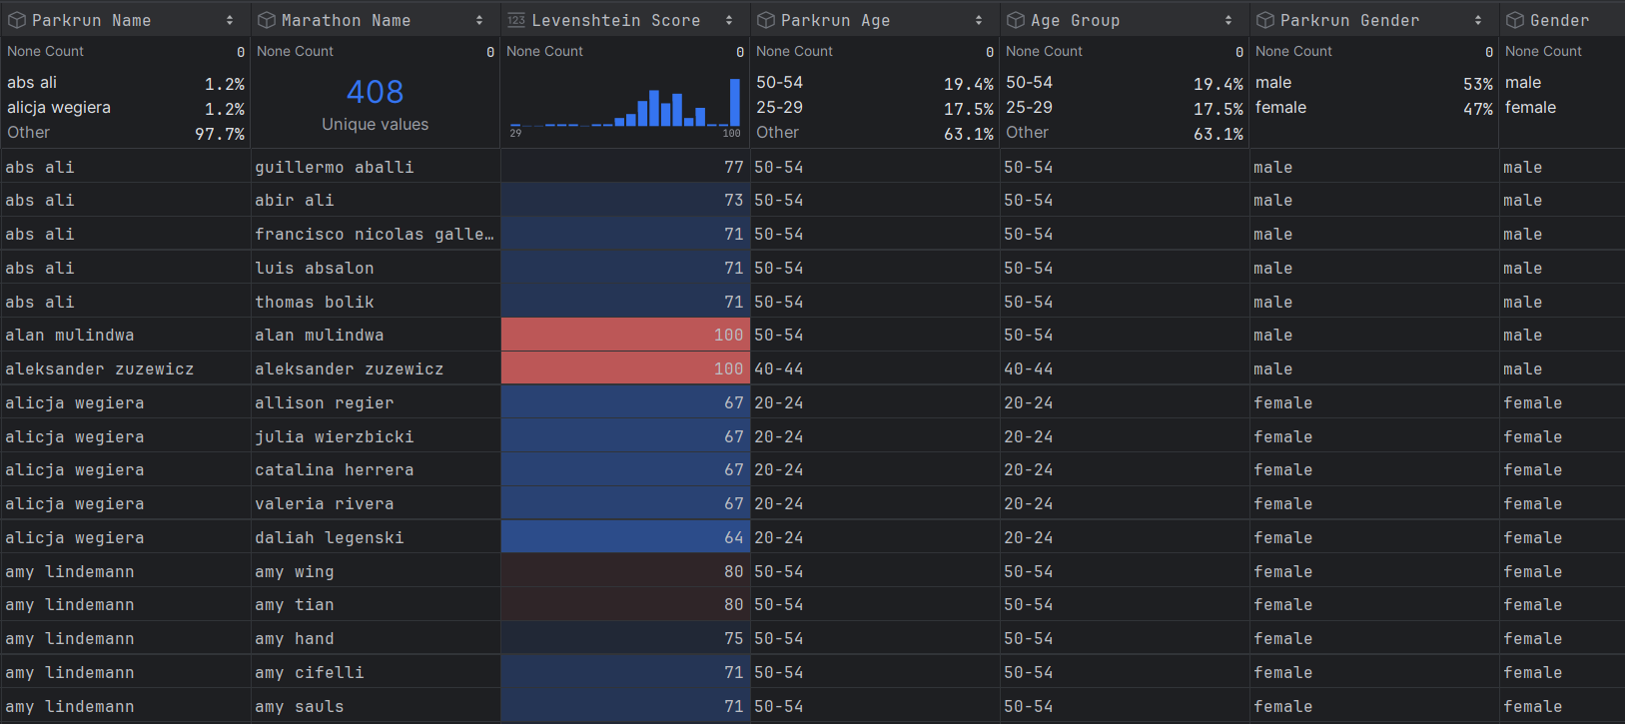
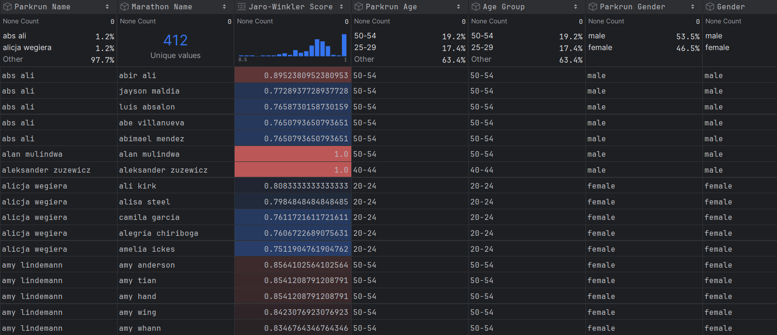
Exact matching: Using Age group and Gender
We create a new dataframe where we perform exact matches on Age group and Gender.
We then order the results by name and similarity scores.
Where the similarity score is 100% certainty (aka exact match), return only that match.
Else, return top 5 similarity scores
Levenshtein Score
Jaro-Winkler Score

Slide 18
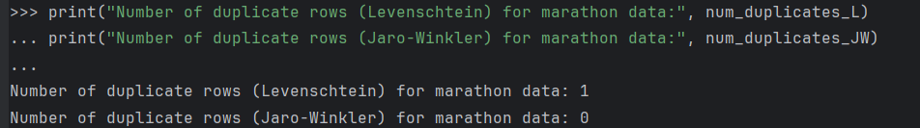
Fuzzy matching: Deduplication
We will restrict our dataset to the top similarity score for each person in the parkrun dataset
Due to the nature of fuzzy matching, duplicate rows can occur where the same person is mapped to two different people
We check our data to see if there are any duplicate rows of data.
There is 1 in the Levenschtein score version of the mapped data:
We apply a simple deduplication method:
Select the record with the highest similarity score between names.
Delete the row(s) with the lowest similarity score.

Slide 19
Validation

Slide 20
Validation: Precision vs recall
Precision
Recall
Of the matches we make, how many are correct?
Example:
If the matching algorithm says ‘100 names match’ and 90 are correct, precision =90%
High precision: low false positives
Trade-off: If you set a very high similarity threshold (e.g., Levenshtein score ≥ 95), precision will increase because only very similar names are matched—but you might miss valid matches.
Of all true matches, how many do we find?
Example:
If there are 120 true matches and the matching algorithm finds 90, recall = 75%
High recall: low false negatives
Trade-off: Lowering the similarity threshold (e.g., Levenshtein score ≥ 80) increases recall because you include more possible matches—but precision may drop.
Solution:
Tiered approach: Auto-accept >90%, manual review 80-90%, reject <80%

Slide 21
Validation: Results
Threshold | Levenshtein Score | Jaro-Winkler Score | Decision
High confidence (>90% similarity score) | 88 | 109 | Auto accept
Medium confidence (<=90%, >80% similarity score) | 31 | 35 | Manual review
Low confidence (<=80% similarity score) | 33 | 8 | Reject

Slide 22
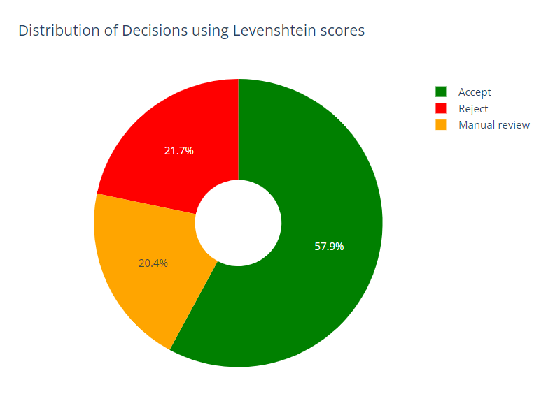
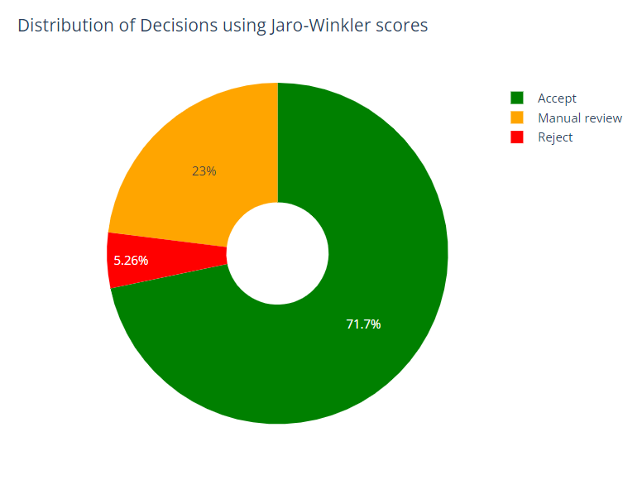
Validation: Results

Slide 23
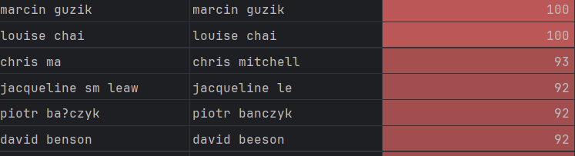
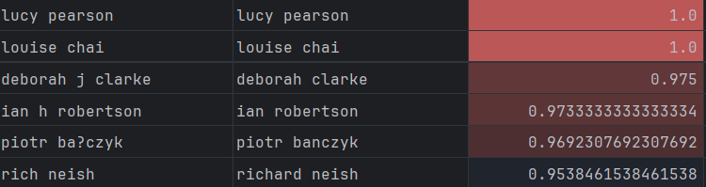
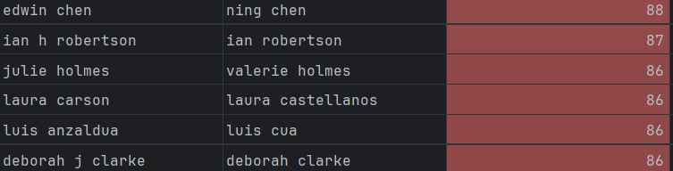
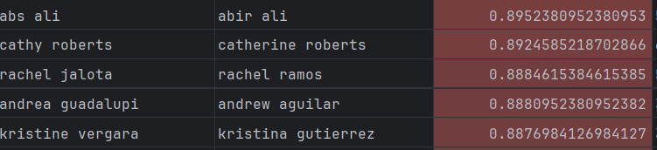
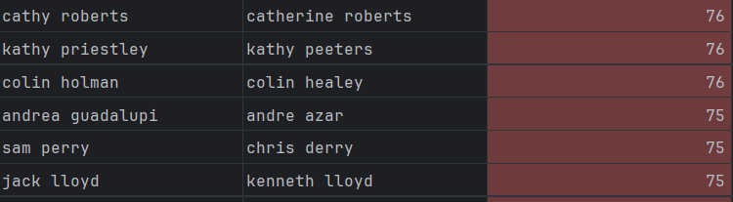
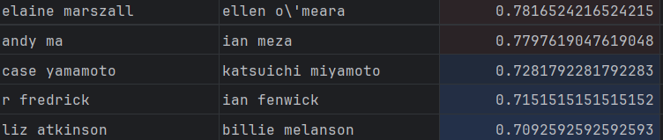
Validation: Results examples
Threshold | Levenshtein Score | Jaro-Winkler Score | Decision
High confidence (>90% similarity score) |  |  | Accept
Medium confidence (<=90%, >80% similarity score) |  |  | Manual review
Low confidence (<=80% similarity score) |  |  | Reject

Slide 24
Insights

Slide 25
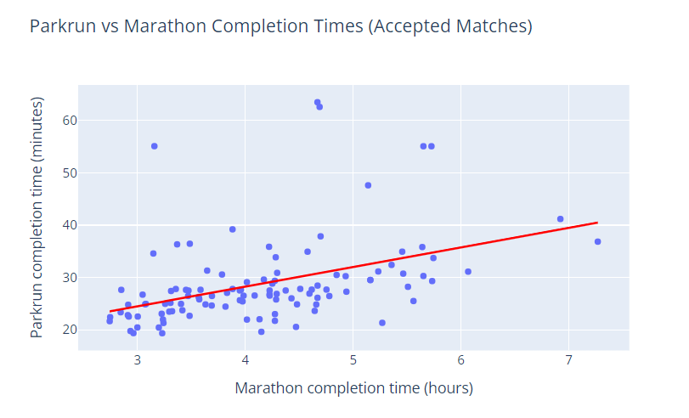
Insights
Correlation between parkrun finish times and marathon finish times?
Posi
Positive correlation!

Slide 26
Risks and mitigations

Slide 27
Risks and Mitigations
Risk | Issue | Mitigation
False positives | Incorrect matches causes to inaccurate merges and data corruption | Multi field matching e.g. age, gender, country, Trial and error to tune thresholds Manual review for borderline scores
False negatives | Legitimate matches might be missed if the similarity score threshold is too strict | Lower similarity threshold Try using phonetic matching (e.g. soundex)
Ambiguity in Common Names | Common names appear frequently, making it hard to distinguish correct matches without additional context (e.g. age, location). | Multi field matching in matching logic Deduping methodology using multiple fields
Lack of contextual understanding | Fuzzy matching is based on character similarity and not meaning. | Evaluate and understand the base data Clean data where there are common subject specific issues (e.g. remove titles like Dr., MD.)

Slide 28
Improvements for future
Split names into first and last components, then calculate a combined similarity score based on both.
This method works particularly well with Jaro-Winkler, as the algorithm gives greater weight to the beginning of strings, improving accuracy when matching first and last names.
Use web scraping to enrich datasets with additional attributes such as running club and country for exact matching.
Incorporating these fields would increase confidence in match accuracy and reduce ambiguity.
Integrate age-grading datasets to compare age-graded performance (%) for 5K versus marathon results.
Incorporating this field would be useful to use in deduping the datasets.
https://github.com/AlanLyttonJones/Age-Grade-Tables/tree/master

Slide 29
Key takeaways

Slide 30
Key takeaways
There is no single perfect method
Exact matching is fast and exact but fails on inconsistencies
Fuzzy matching catches variations but risks false positives/negatives
Multi field strategies best
Combination of fuzzy matching fields and exact matching fields
Always expect errors
False positives and false negatives are inevitable - design for human review

Slide 31
Questions?

Slide 32
Nia Comley
Data and analytics developer
nia.comley@jisc.ac.uk

